Slide 1
Data Science Basics in R:
Day 2: Data management

Slide 2
Goals for today
Understand what data management is
Identify some interesting sources of healthcare and public health
Load and clean your first dataset in R
Learn about and implement best practices for:
documenting your code
data dictionaries
doing reproducible research in R
Create a github account

Slide 3
What is data management?

Slide 4
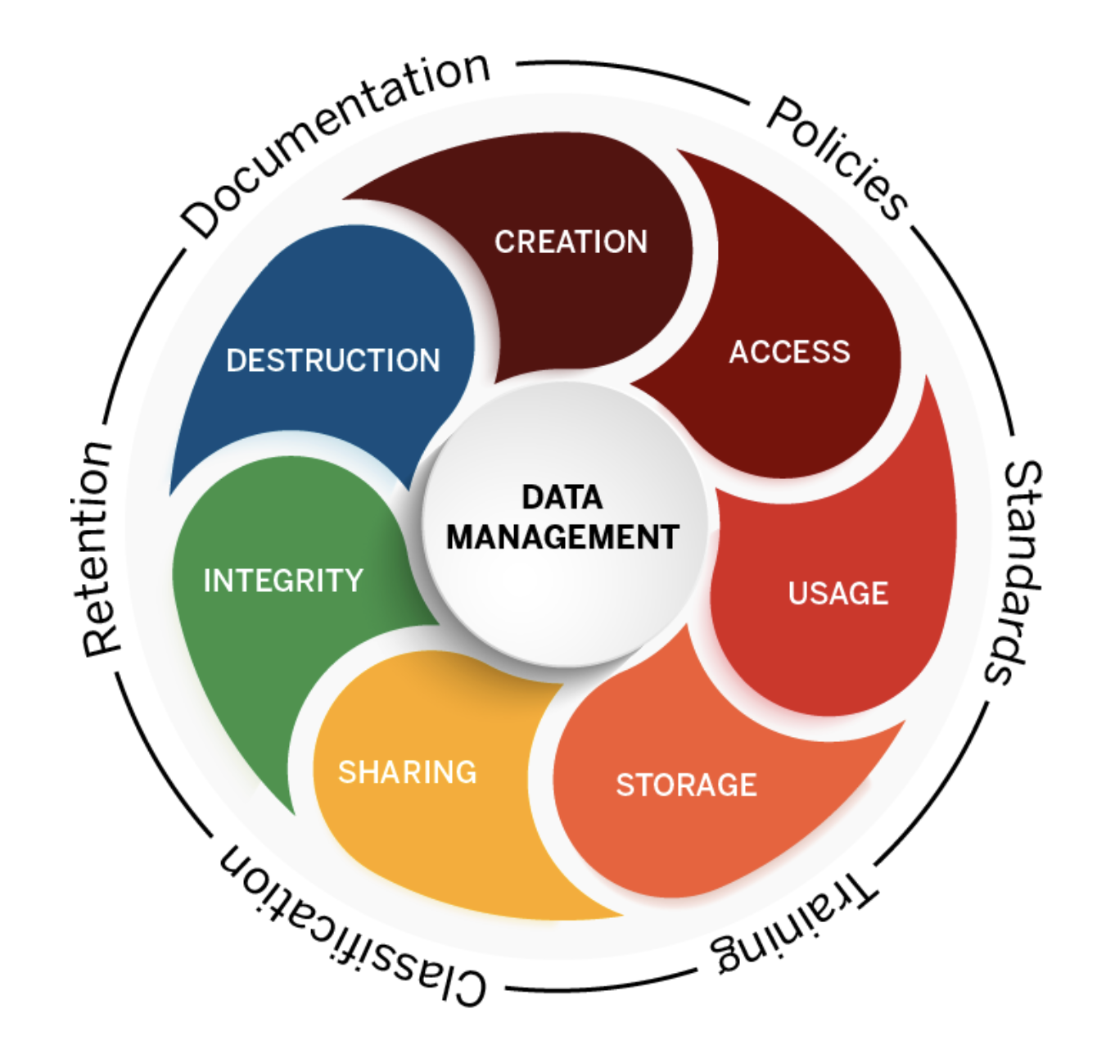
Data management
Data management is the practice of creating, maintaining, documenting, and securing data.
It includes data cleaning, among many other tasks.
Graphic from https://datamanagement.iu.edu/

Slide 5
What does data cleaning involve?
Better question: what doesn’t it involve?
Data cleaning tasks depending on what types of data you’re working with and where you got them!
Identifying and addressing missing values
Fixing “weird” characters
Combining multiple datasets
Deduplicating lists
Identifying other discrepancies…

Slide 6
Some useful sources of global health security data

Slide 7
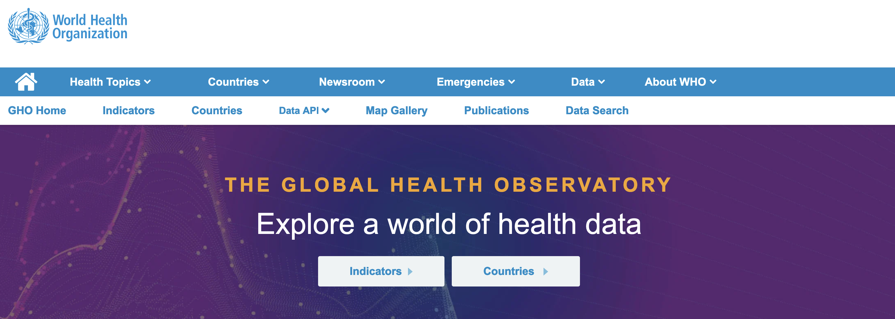
WHO Global Health Observatory
https://www.who.int/data/gho

Slide 8
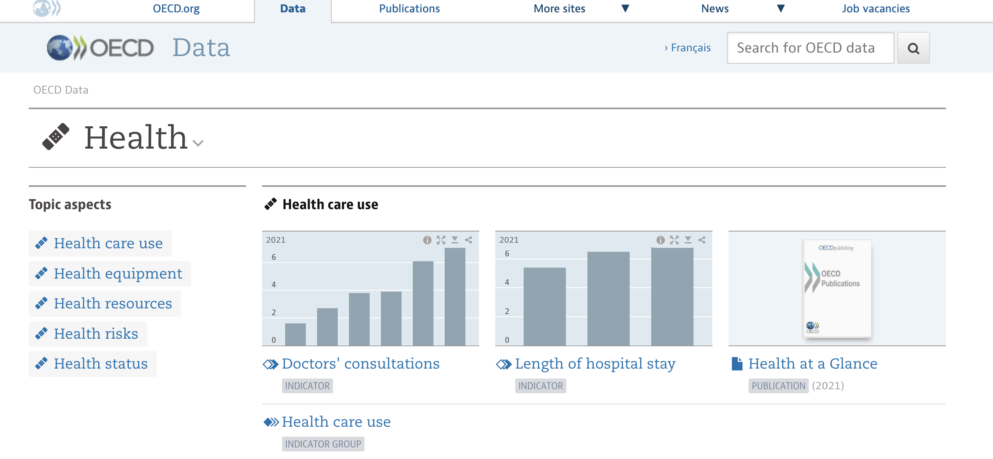
OECD Health Data Repository
https://data.oecd.org/health.htm

Slide 9
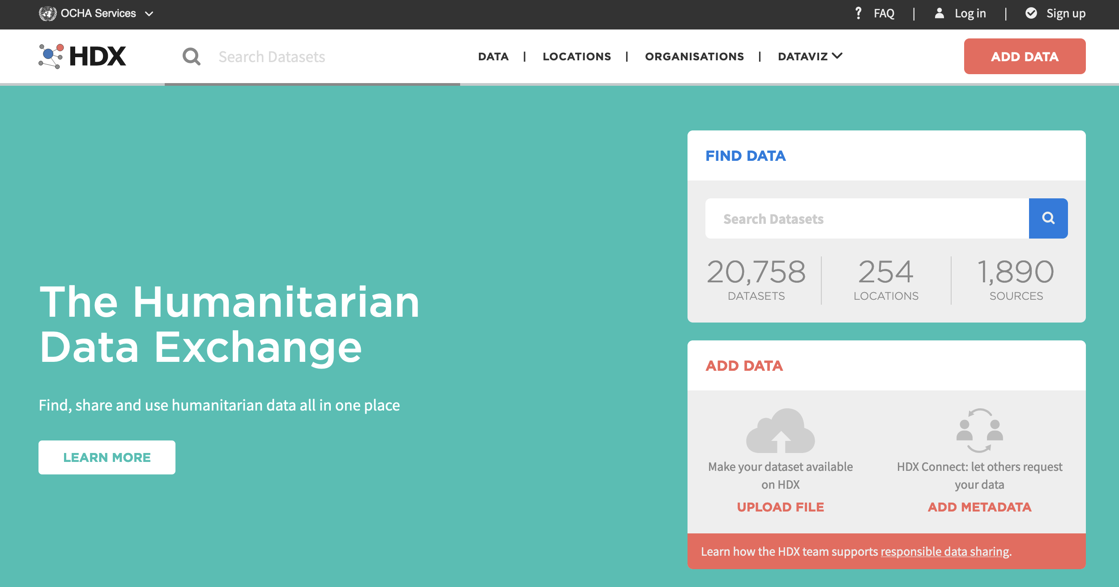
OCHA Humanitarian Data Exchange
https://data.humdata.org/

Slide 10

Demographic and Health Surveys
https://dhsprogram.com/

Slide 11
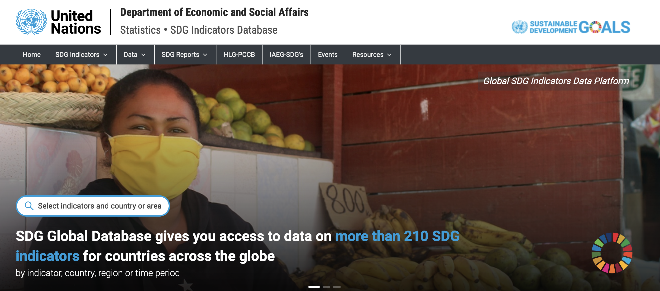
UN SDG Global Database
https://unstats.un.org/sdgs/dataportal

Slide 12
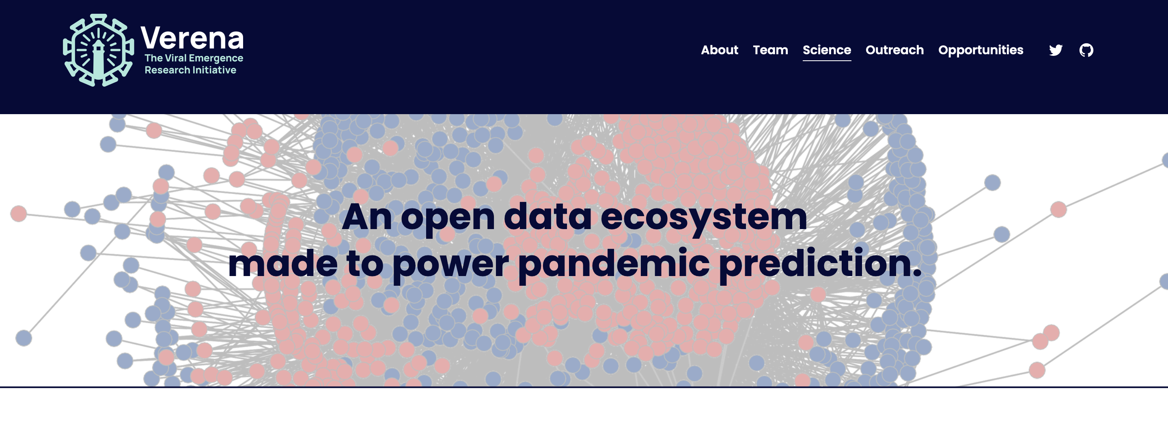
Verena
https://www.viralemergence.org/data

Slide 13
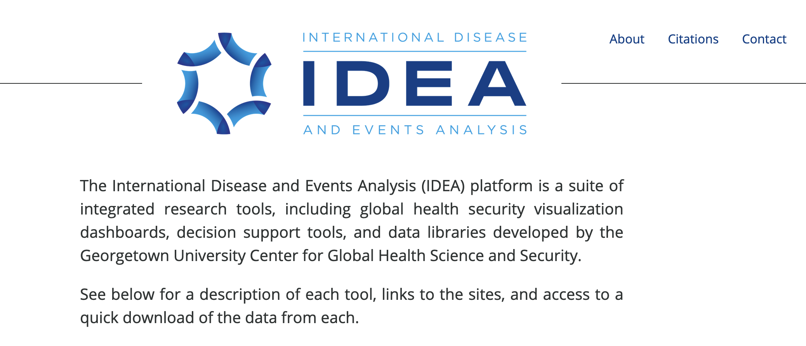
IDEA
https://ghssidea.org/

Slide 14
Let’s chat
What other datasets have you used for work or school?

Slide 15
Exploring the UN SDG Database

Slide 16
UN Sustainable Development Goals (SDG)
2030 Agenda for Sustainable Development
adopted by all UN Member States in 2015
identify 17 Sustainable Development Goals (SDGs)
efforts coordinated and supported by UN Department of Economic and Social Affairs (UNDESA)
Goals are broad, with thematic areas including water, energy, climate, oceans, urbanization, transport, science and technology, and safety/security
Learn more at https://sdgs.un.org/goals

Slide 17

Your turn
Spend a few minutes learning more about the UN SDGs at sdgs.un.org/goals

Slide 18
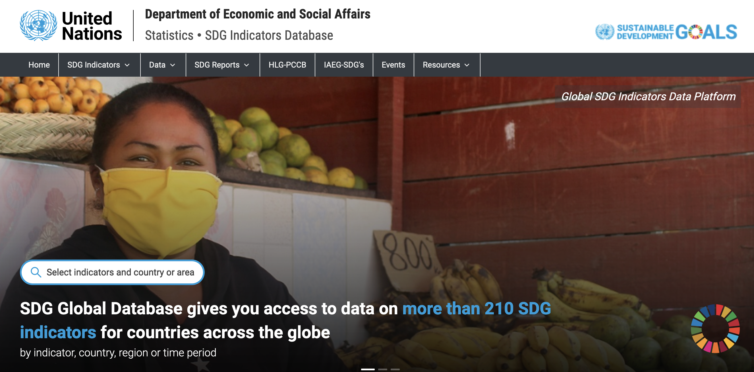
UN SDG Data portal
https://unstats.un.org/sdgs/dataportal

Slide 19
UN SDG Data portal
https://unstats.un.org/sdgs/dataportal

Slide 20
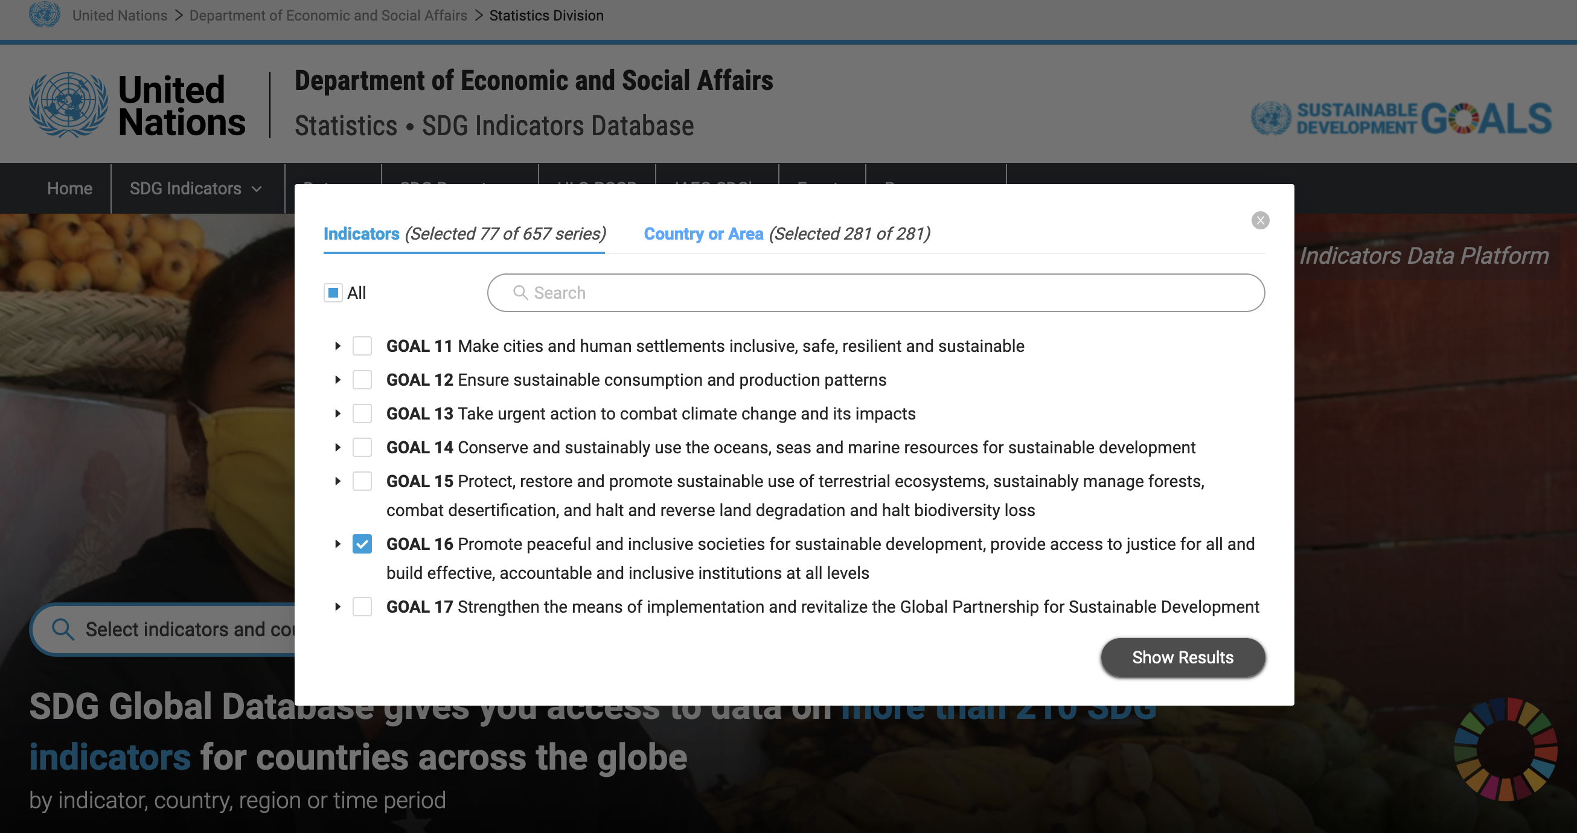
UN SDG Data portal
https://unstats.un.org/sdgs/dataportal

Slide 21
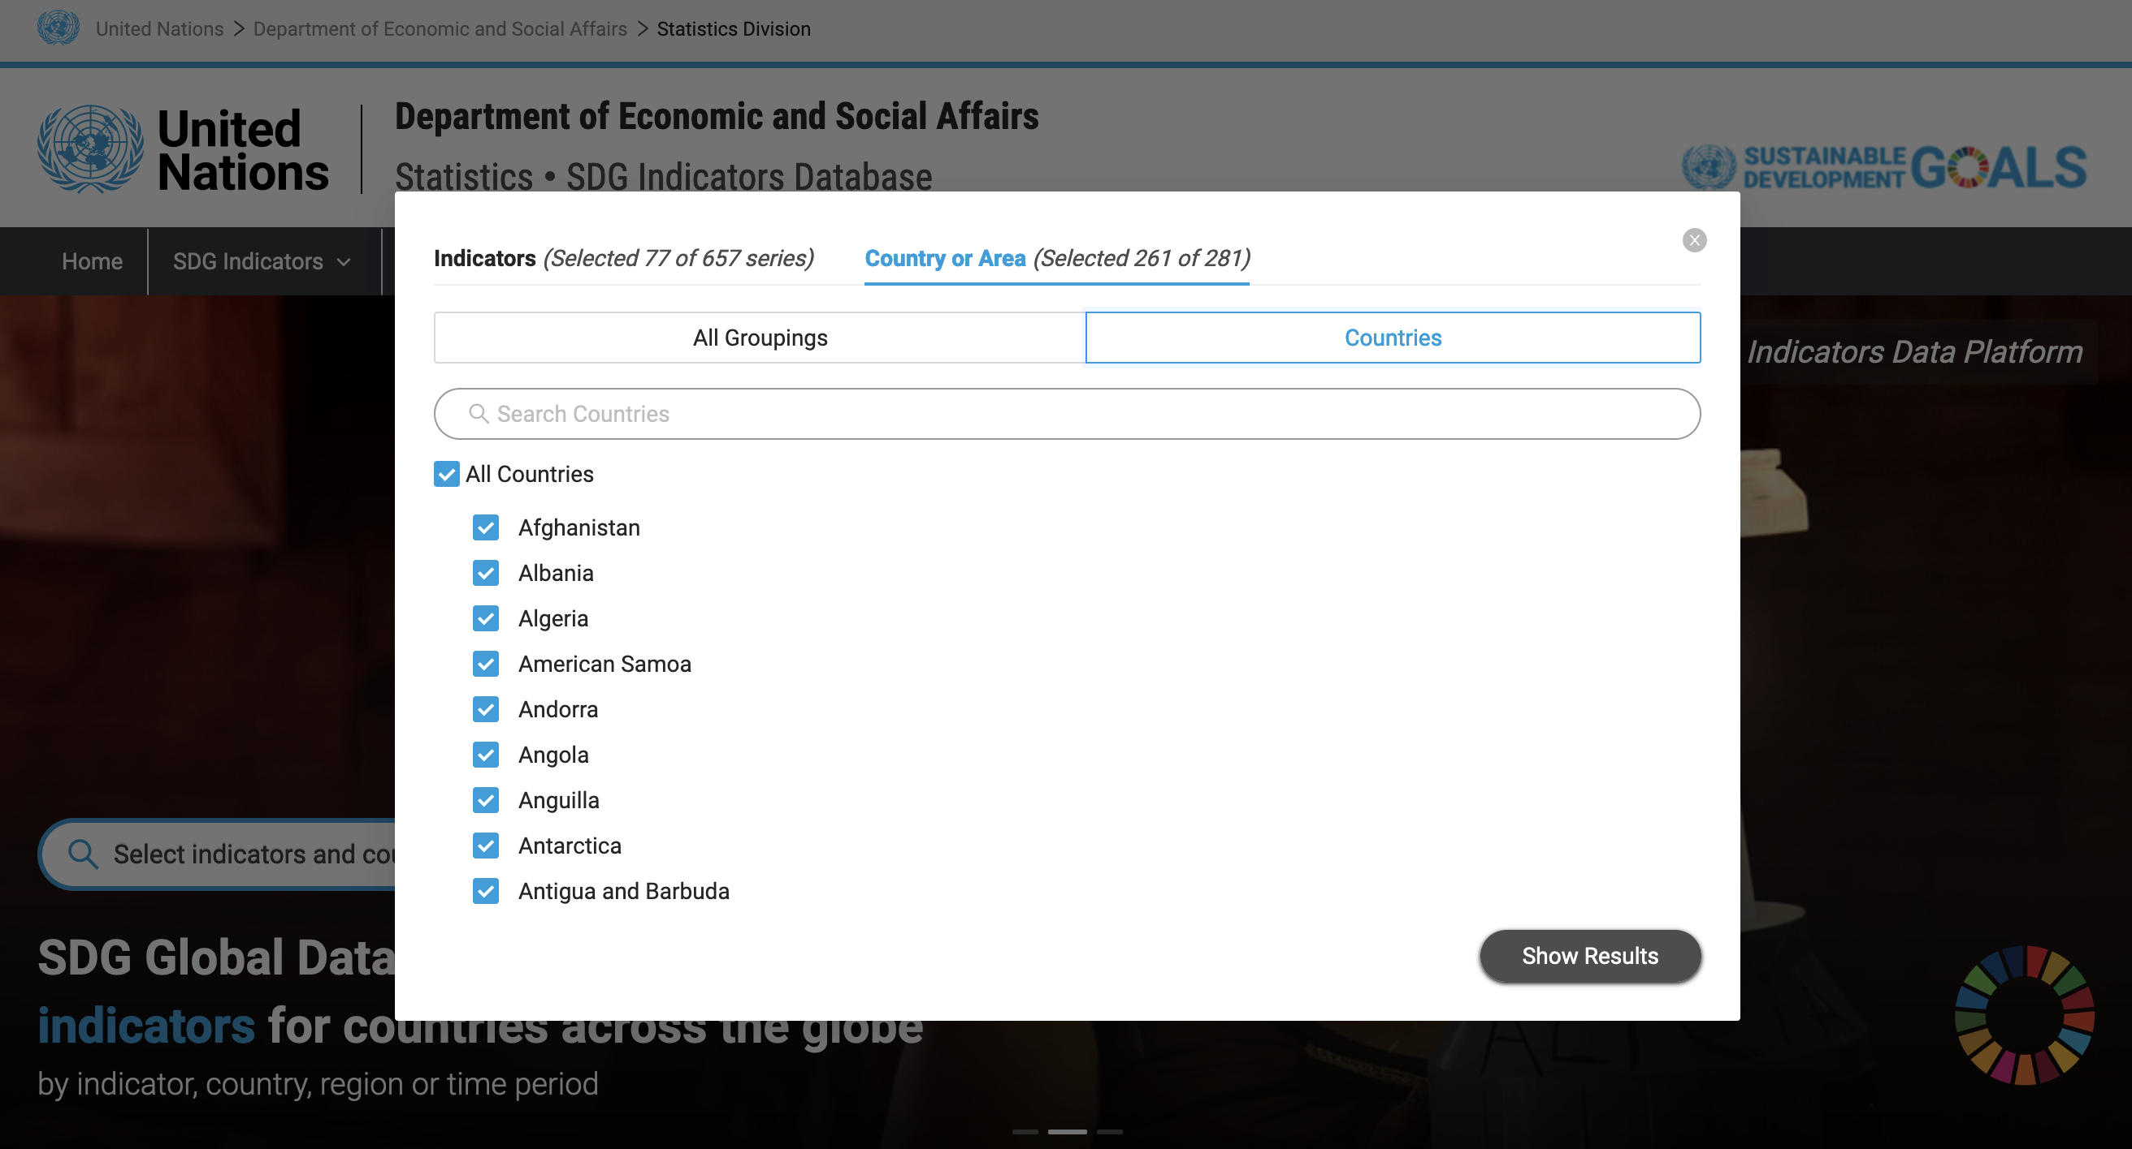
UN SDG Data portal
https://unstats.un.org/sdgs/dataportal

Slide 22
UN SDG Data portal
https://unstats.un.org/sdgs/dataportal

Slide 23
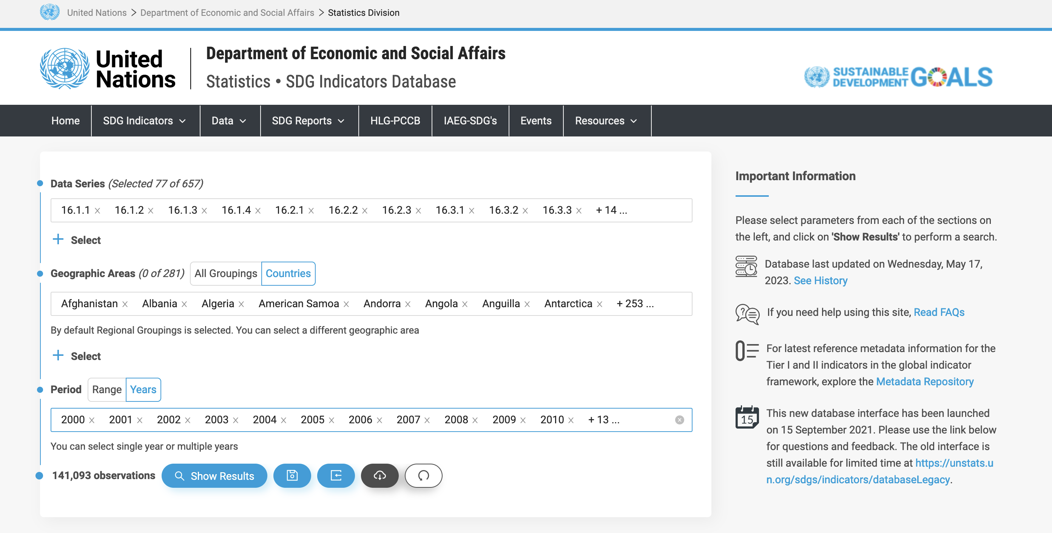
UN SDG Data portal
https://unstats.un.org/sdgs/dataportal

Slide 24
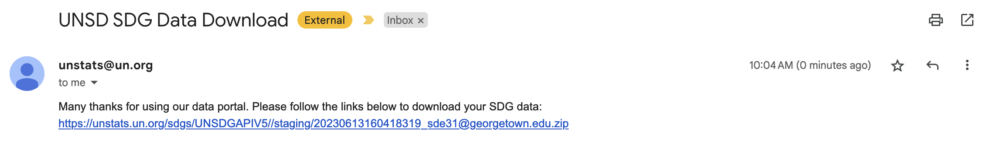
UN SDG Data portal
https://unstats.un.org/sdgs/dataportal
For larger file downloads, you may need to share your email and receive access to a file by email

Slide 25
Data cleaning demo
(see day2/demo in github for materials)

Slide 26
Loading datasets in R

Slide 27
Raw data files
We’re going to talk about structured, flat files today, but there are many types of data that R can work with!
Excel: proprietary file format (Microsoft), but common
CSV: comma-separated values
TSV: tab-separated values

Slide 28
Functions to load data
Excel: read_excel()
CSV: read.csv()
TSV: read.delim()
Example: read.delim("countries.tsv")

Slide 29
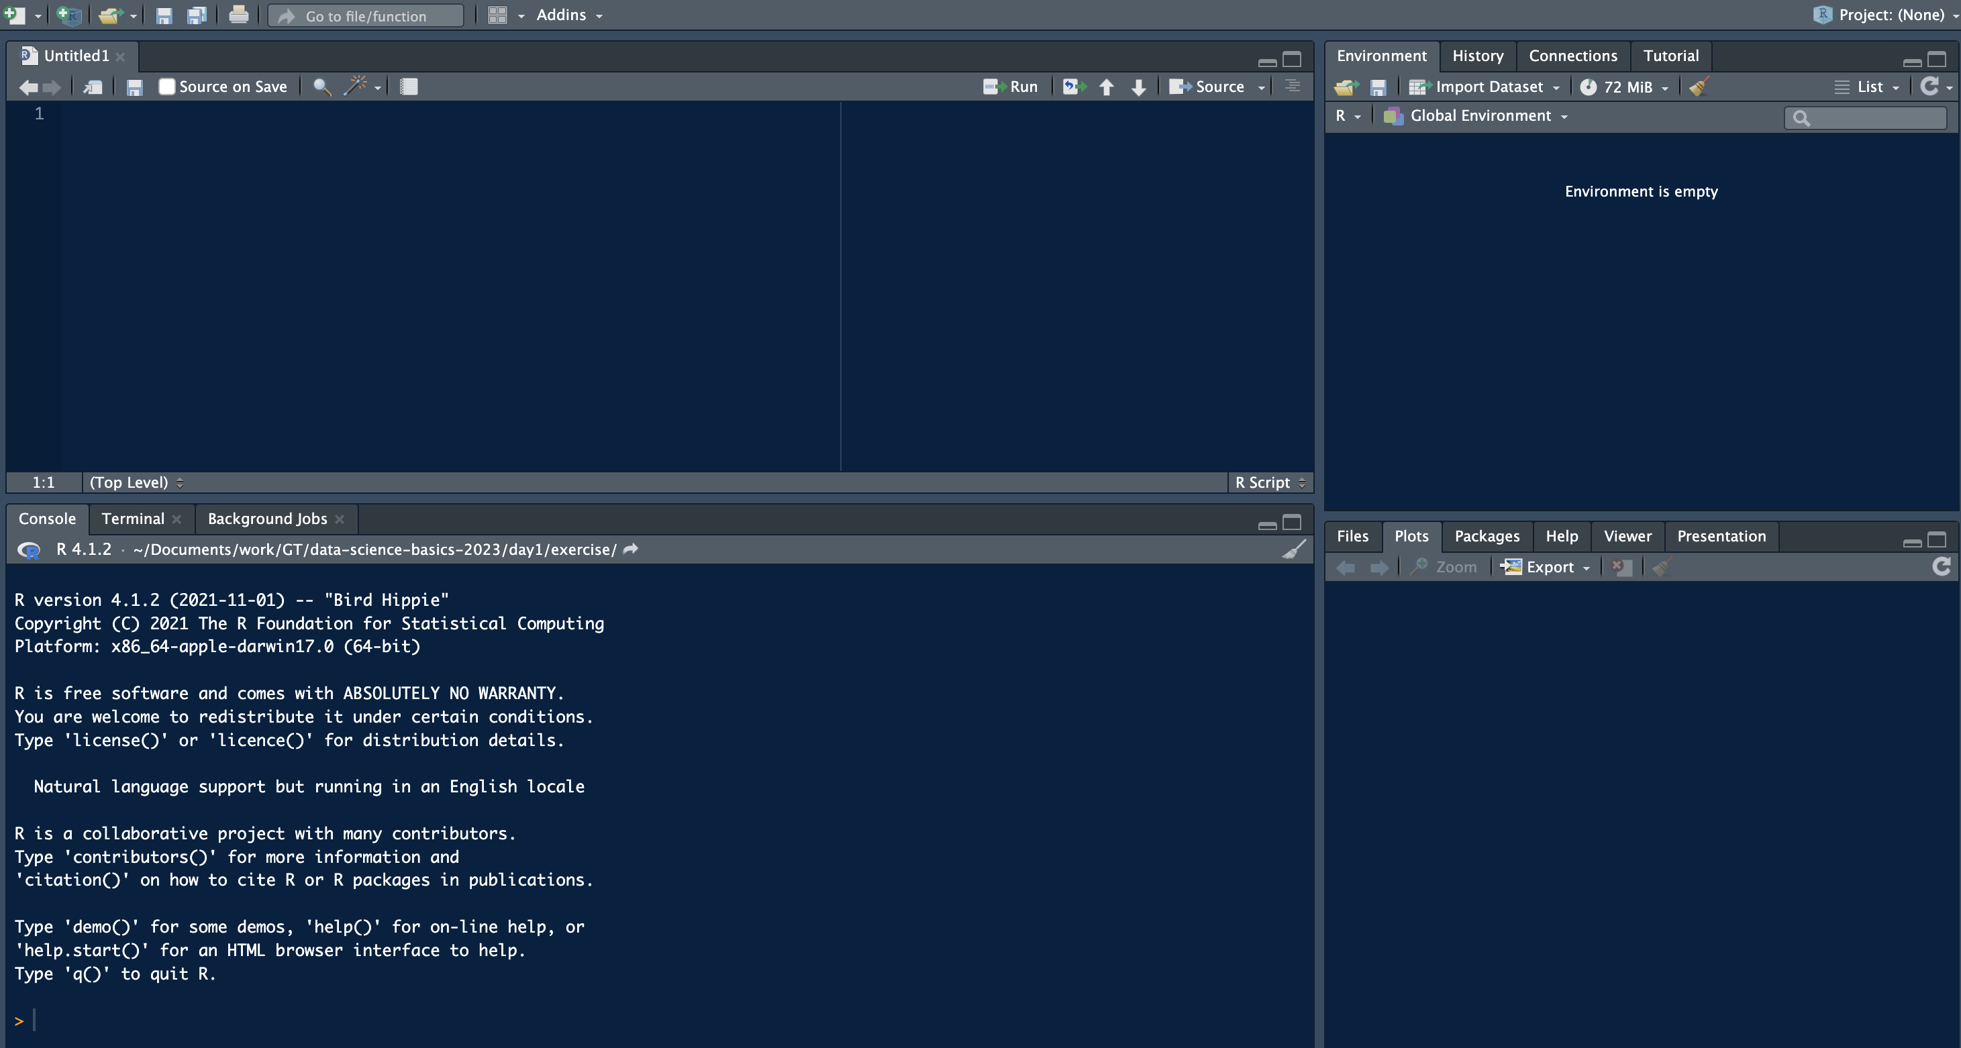
Loading data with RStudio
Import dataset button

Slide 30
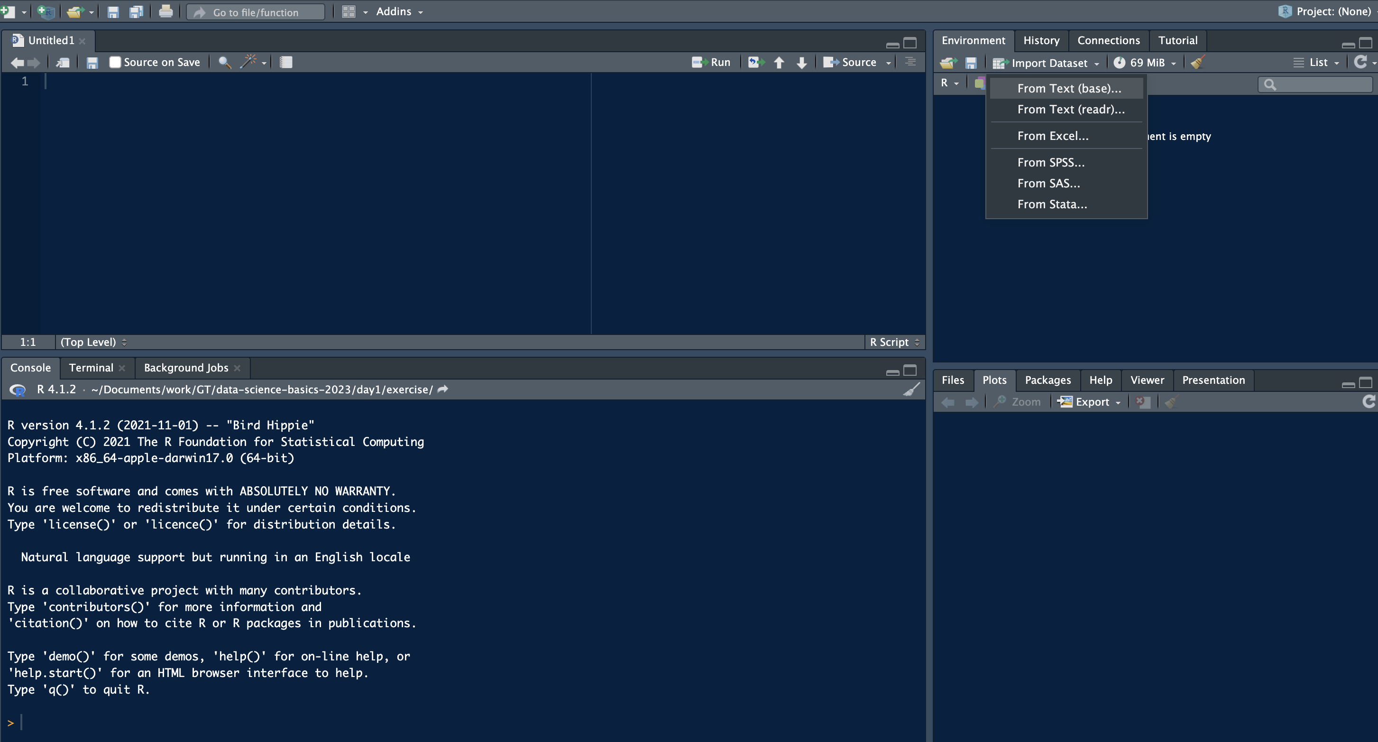
Loading data with RStudio
Several default options of data types, including Excel. Here, I’ll select the first option, using base R

Slide 31
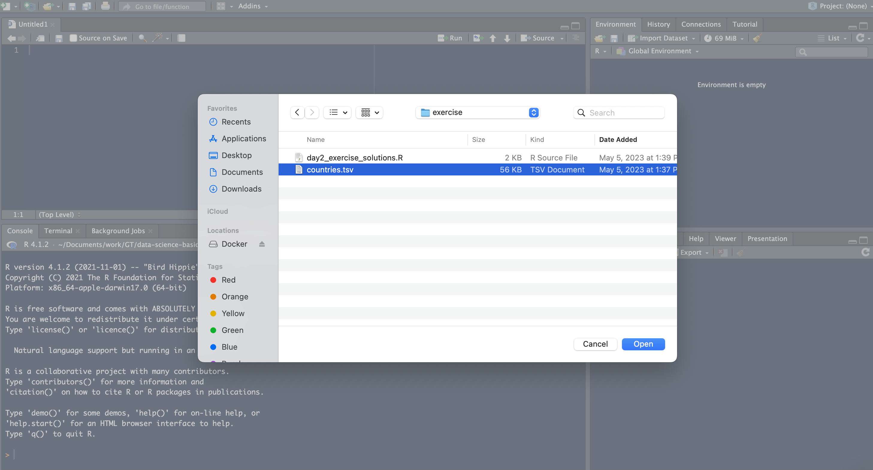
Loading data with RStudio
Select your data file, you might need to look around

Slide 32
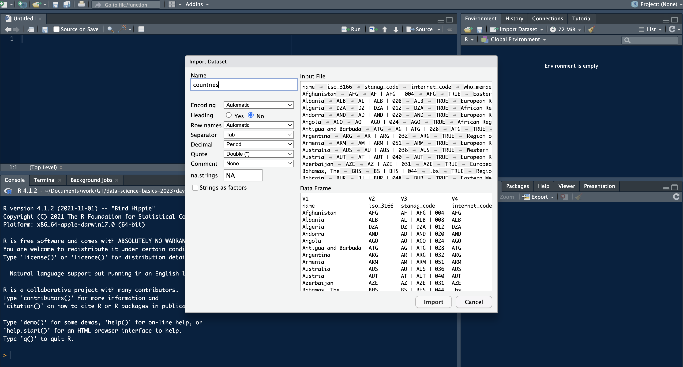
Loading data with RStudio
R will need some help, probably

Slide 33
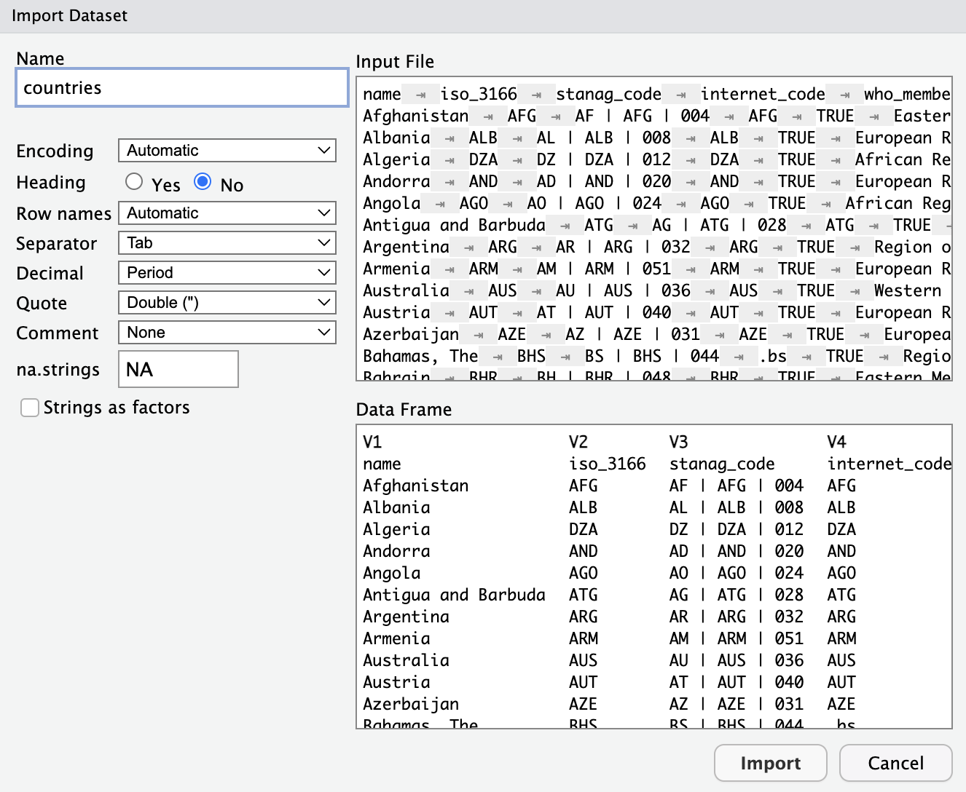
Loading data with RStudio
Here, I needed to tell R that this dataset does have a heading
R will need some help, probably

Slide 34
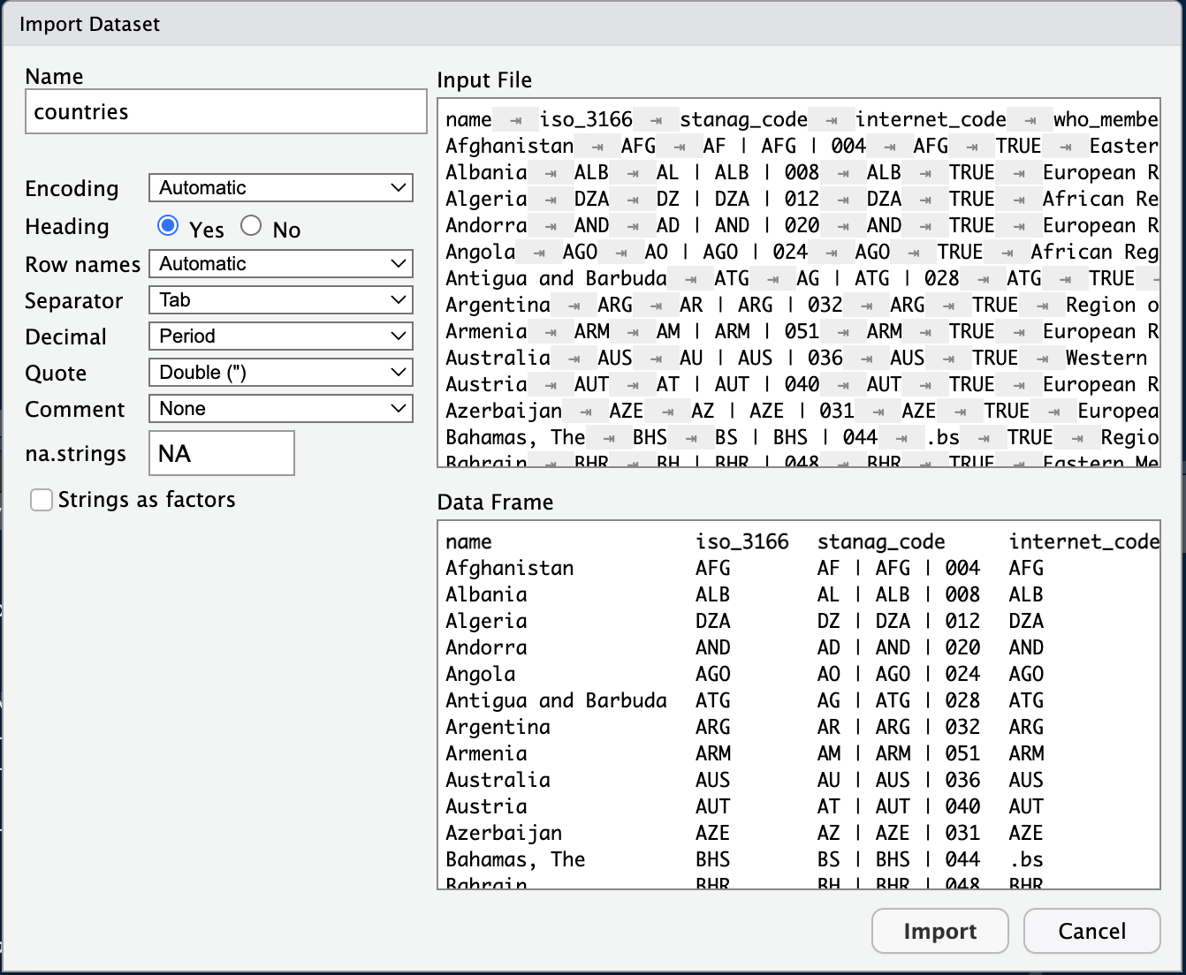
Loading data with RStudio
Fixed the heading!
R will need some help, probably
Click “Import”

Slide 35
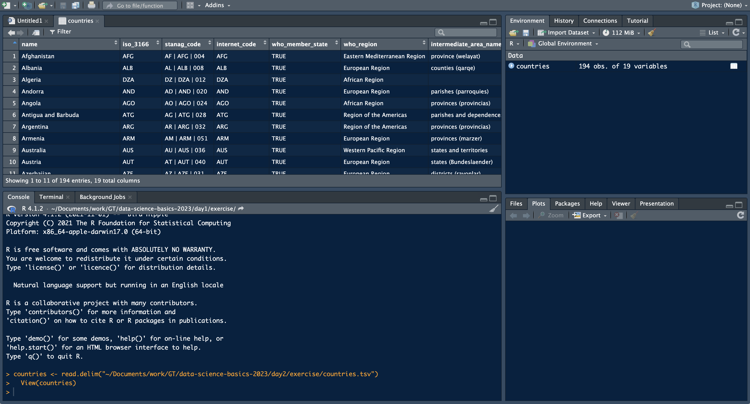
Loading data with RStudio
There are our data!

Slide 36
Loading data with RStudio
R Studio automatically write code for us, see read.delim() function

Slide 37
Loading data with RStudio
And the View() function told R to show us the data table above

Slide 38
Loading data with RStudio
countries dataset in our R environment

Slide 39
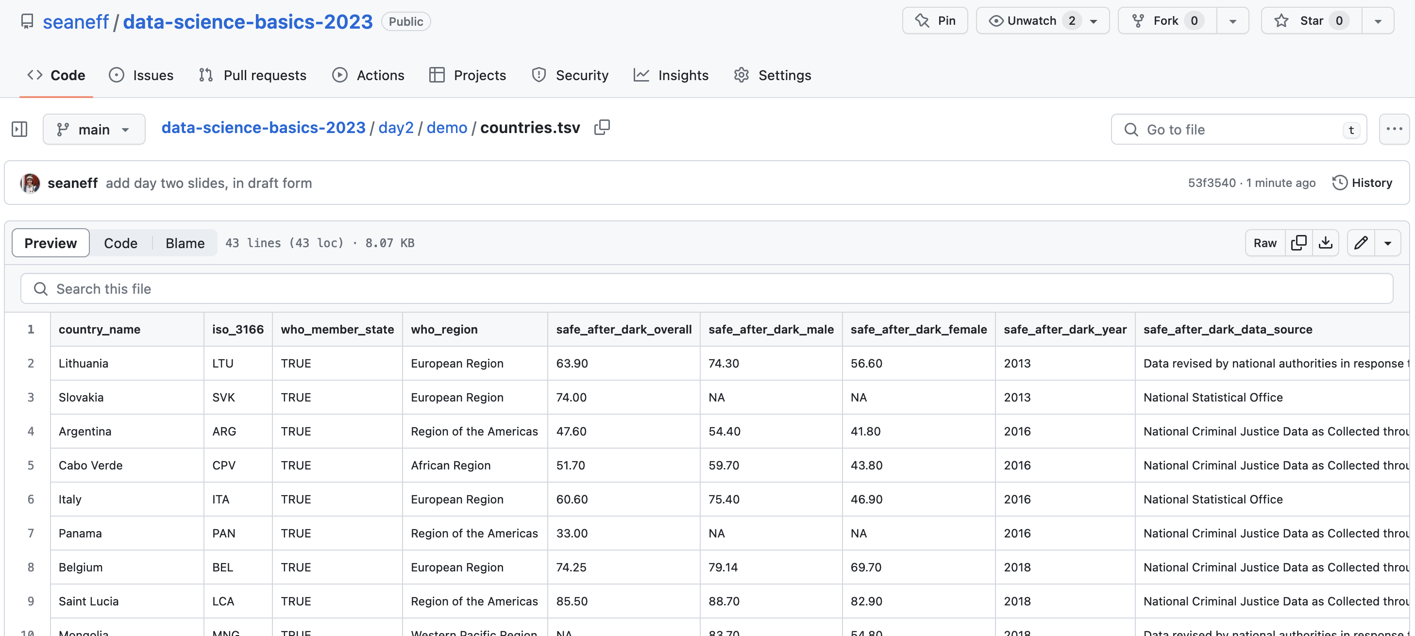
Workshop dataset
countries dataset in our R environment

Slide 40
Workshop dataset
bit.ly/health_diplomacy_day2_data
countries dataset in our R environment

Slide 41
Your turn
Go to bit.ly/health_diplomacy_day2_data
Copy URL
Read data into R
read.delim(“https://raw.githubusercontent.com/seaneff/data-science-basics-2023/main/reference-dataset/countries.tsv”)
countries dataset in our R environment
Notes:
bit.ly/3qs51XU

Slide 42
Data structures in R

Slide 43
Data Structures in R
Yesterday we discussed vectors, today, we’re going to talk about other types of data structures in R. There are a few different types, but the ones we’ll talk about this week are:
vectors: group of data elements of a certain type (1D)
matrix: group of data elements of a certain type (2D)
data frame: group of data elements with different types

Slide 44
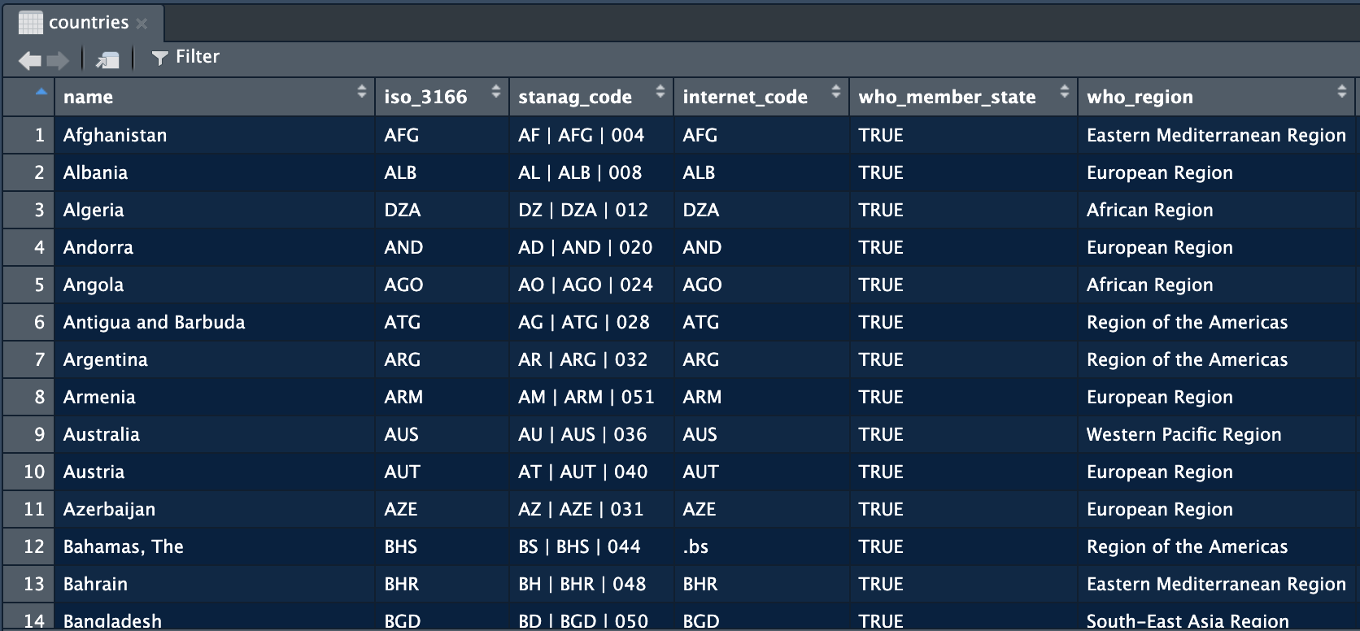
Vectors

Slide 45
Dataframe

Slide 46
Now you try!
Can you find a logical vector?
A character vector?
A numeric vector?

Slide 47
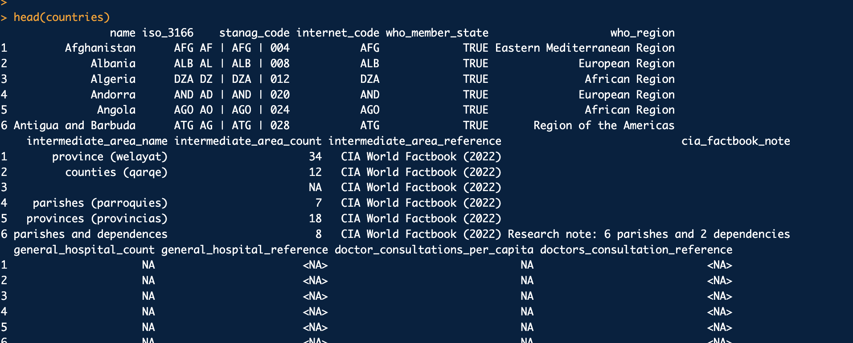
Exploring your dataset
head() function

Slide 48
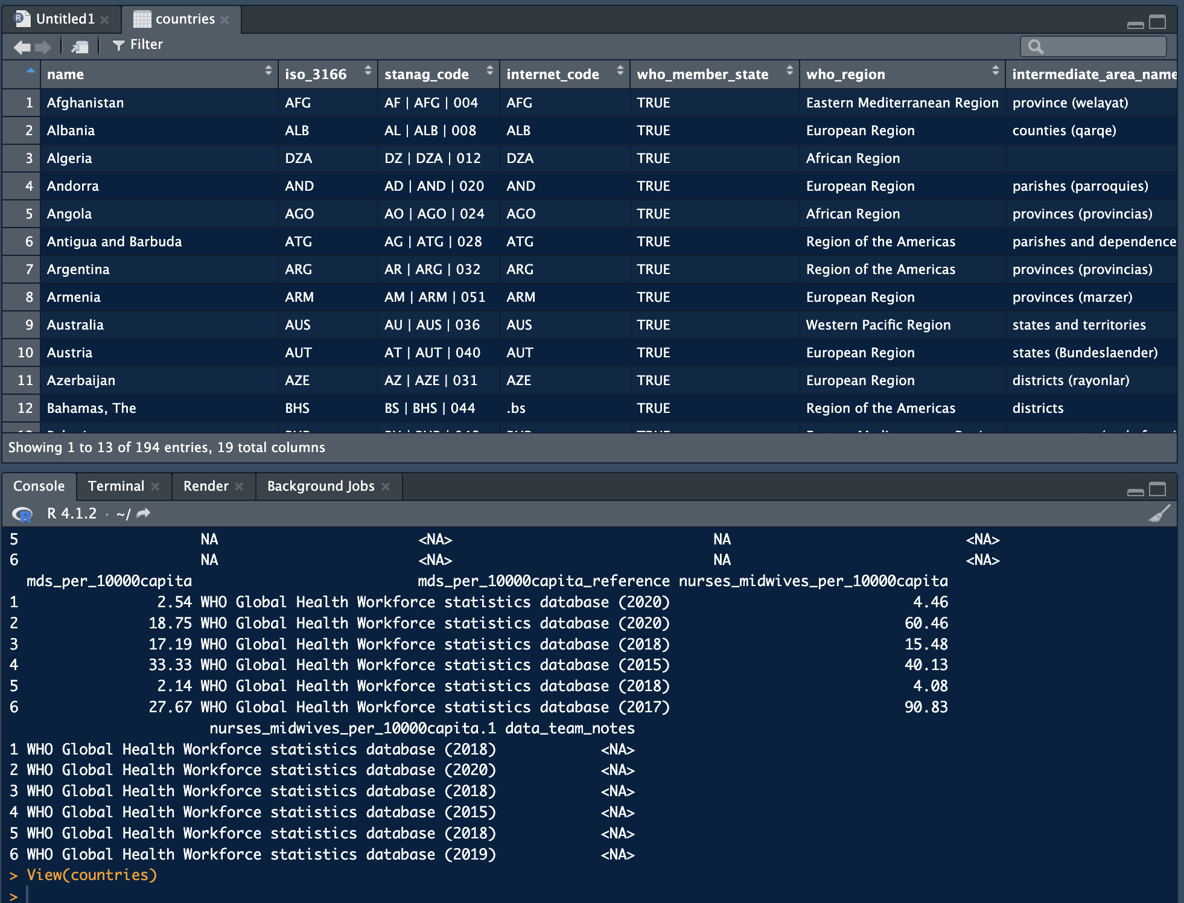
Exploring your dataset
View() function

Slide 49
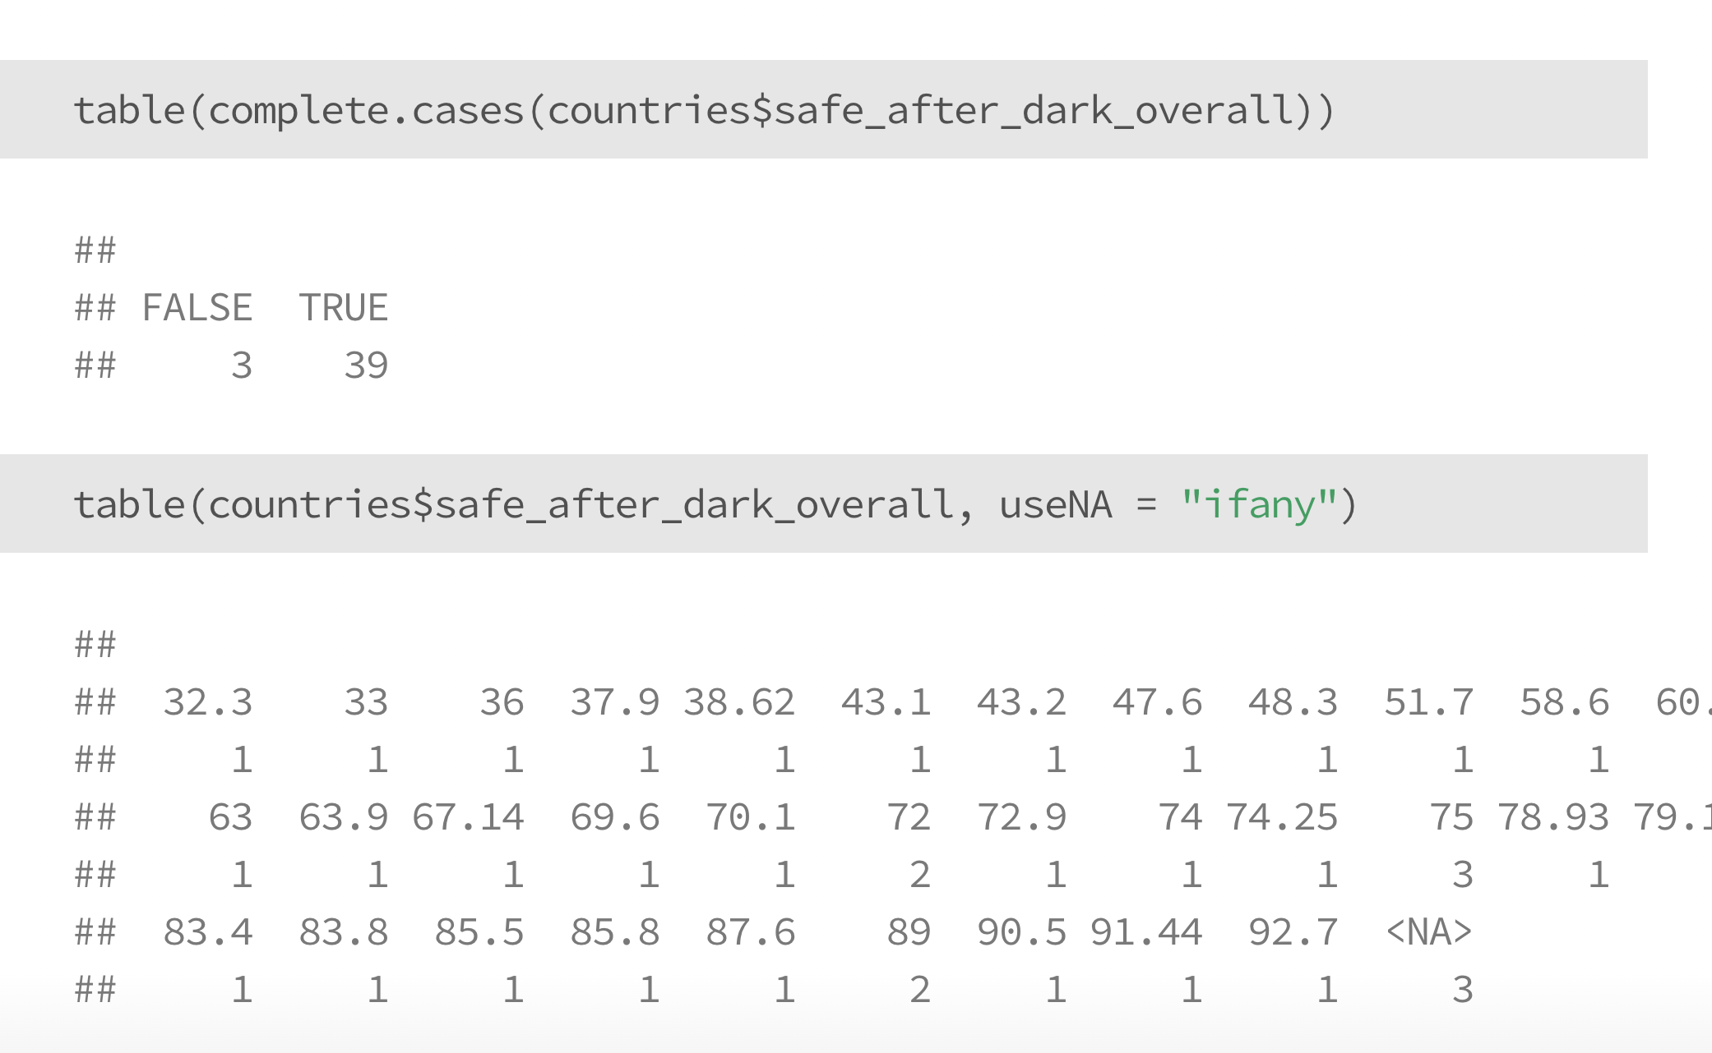
Exploring your dataset
Check for missing values

Slide 50
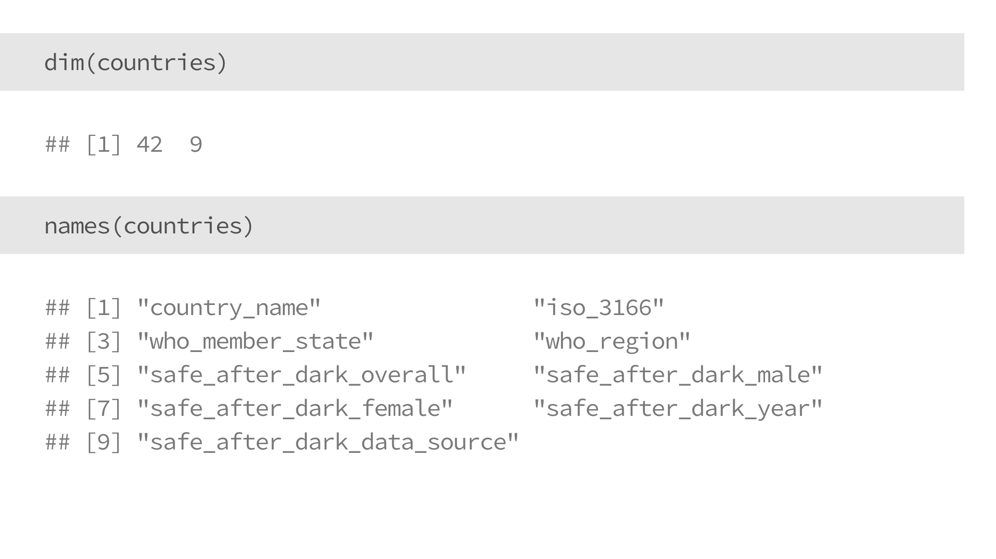
Exploring your dataset
Dimensions and field names

Slide 51
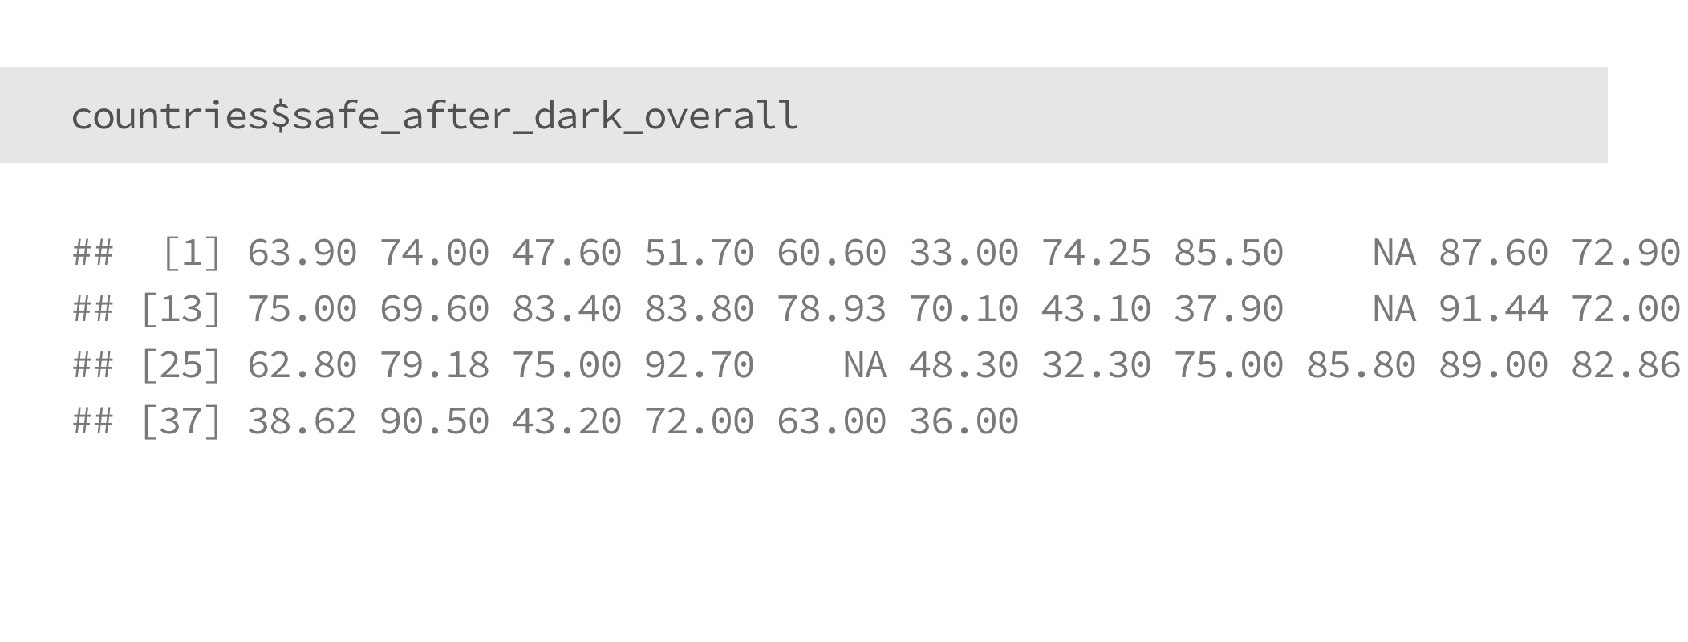
Accessing subsets of data
Using $ to call vectors

Slide 52
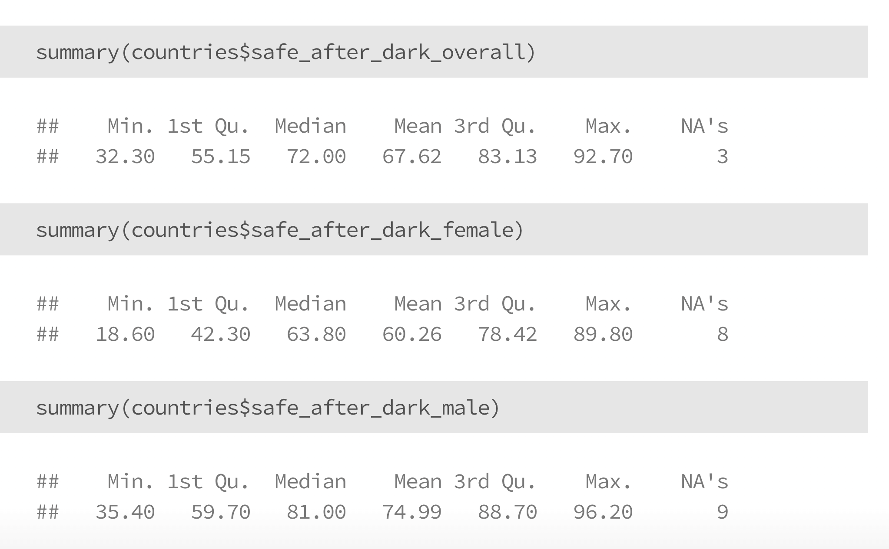
Ask questions about your data

Slide 53
Now you try!
Take five minutes to explore this dataset
How many rows are there?
How many columns are there?
Can you use “$” to select a vector?

Slide 54
Documenting your data, code, and results

Slide 55
Documentation
Throughout your analysis, documentation might be the single most important, and also the single most under-appreciated step of the process.
Documentation is helpful for :
current you: writing out simple, clear, documentation helps you think clearly
future you: you’ll inevitably forget why you did certain things, even if you can see your old code
others: hopefully other people will also use your work, and they need to know about it

Slide 56
Documentation
Different materials, and different types of analysis benefit from different types of documentation.
Datasets: Data dictionaries, rules to generate datasets
Code: Comments in code, README files
Analysis/Results: Methods documentation, in a word document, a google document, or in github

Slide 57
Documenting datasets:
Data dictionaries
The most common way to document a dataset is a data dictionary. At a minimum, data dictionaries:
Define the columns (“fields”) of a dataset
Specify what a row corresponds to (e.g., one country)
Give context about what the data are, including where they come from and how often they are updated

Slide 58
Documenting datasets:
Data dictionaries
Data dictionaries come in lots of formats and flavors. Work with the type that makes the most sense for who you are trying to communicate with.
You can see in the course references/ folder for today a few different examples of data dictionaries, with URLs for future reference.

Slide 59
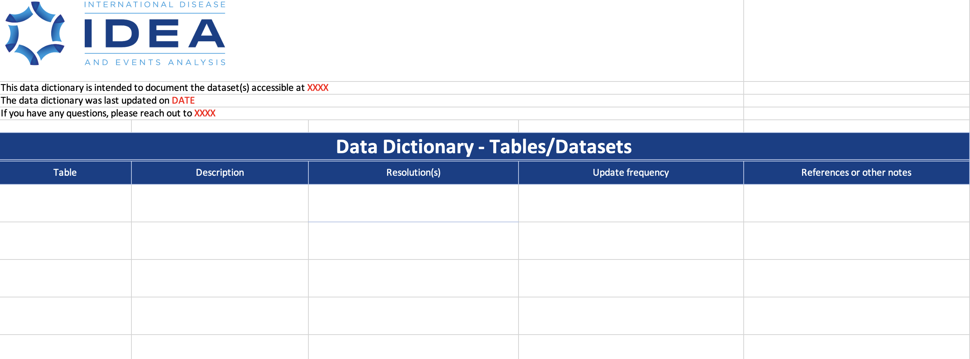
Documenting datasets:
Data dictionaries

Slide 60
Your turn!
Let’s work together to fill out a data dictionary for the dataset we created together in class today.

Slide 61
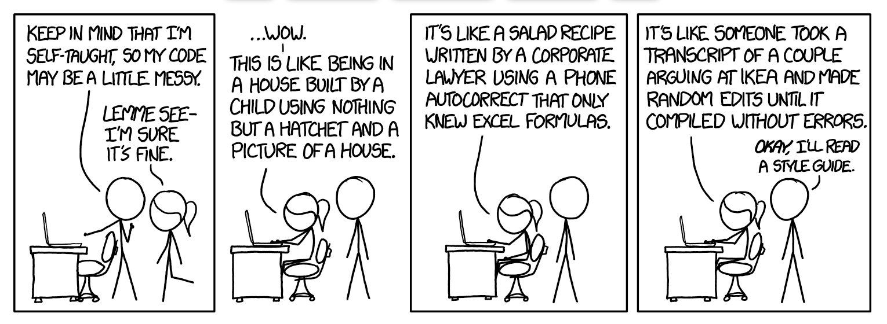
Documenting code:
comments
As we start writing code, it’s helpful to leave “notes” for yourself and others reminding yourself what you did
Comments can also help break code into sections
Comic by XKCD

Slide 62
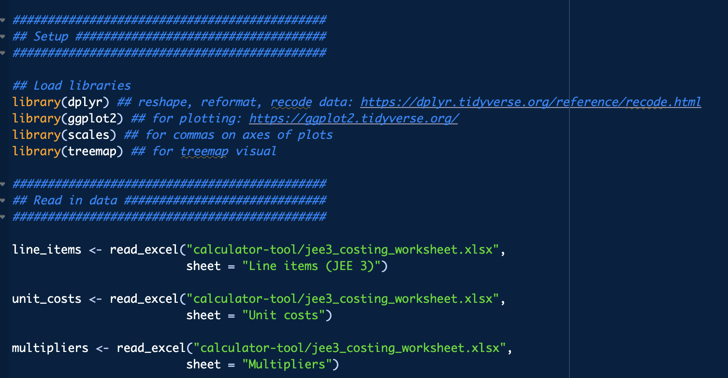
Documenting code:
comments

Slide 63
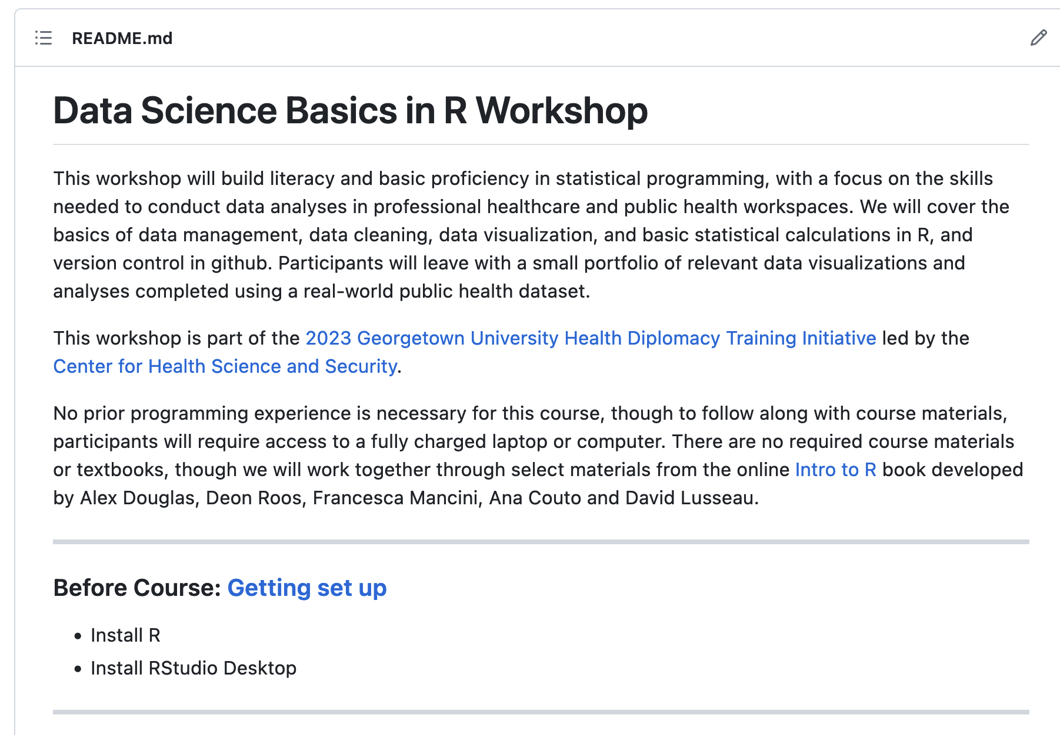
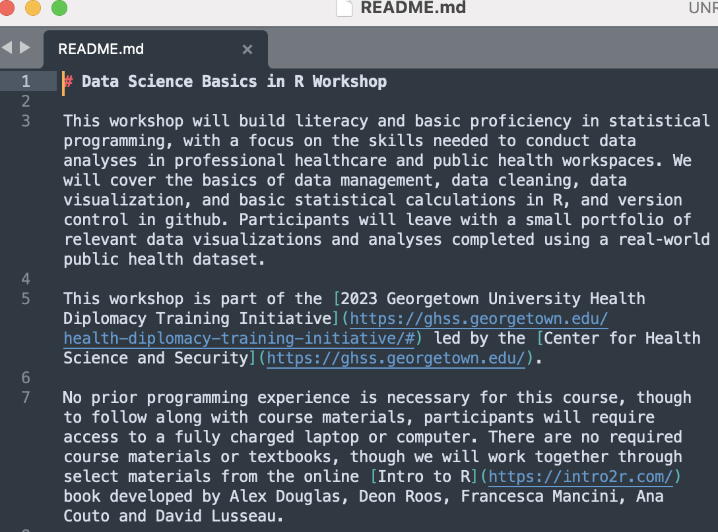
Documenting code:
README files
README files summarize the contents of a specific folder
Common in github, rendered using Markdown

Slide 64
Reproducible results
We won’t cover it in detail in this workshop, but R is a great way to ensure that your code, and your results, are well documented and reproducible
Use a single version of a clean dataset
Document and version your data cleaning decisions
Store your code, results, & documentation in one spot

Slide 65
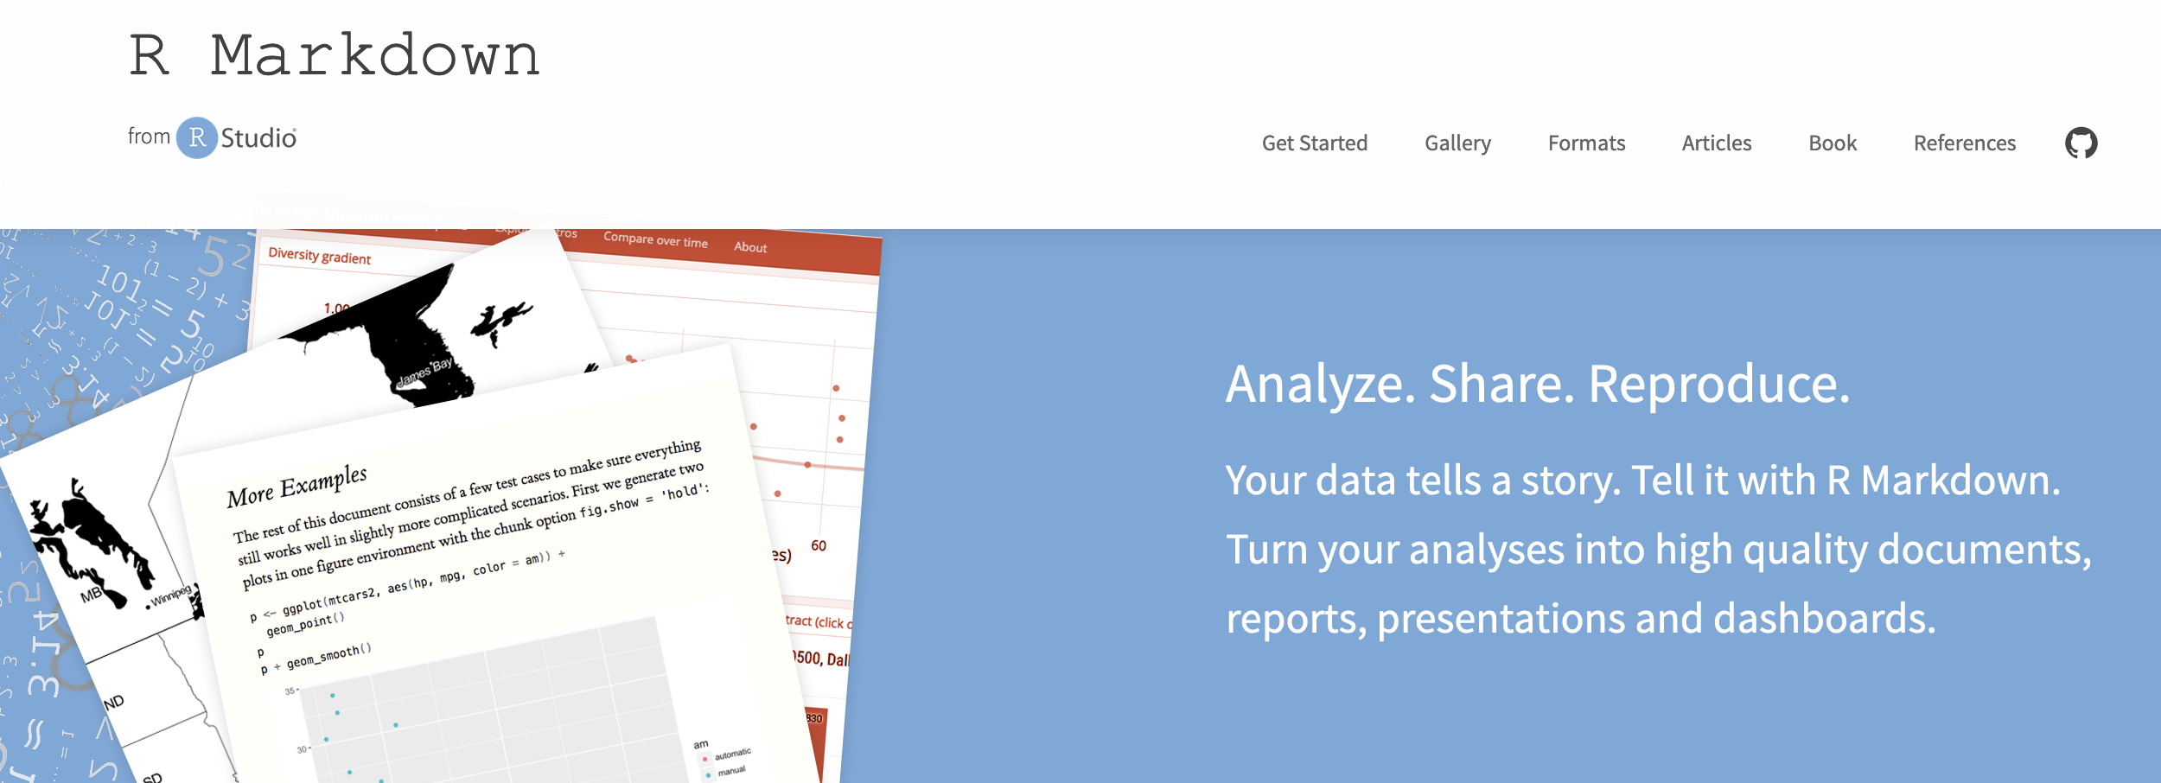
Reproducible results
R Markdown

Slide 66
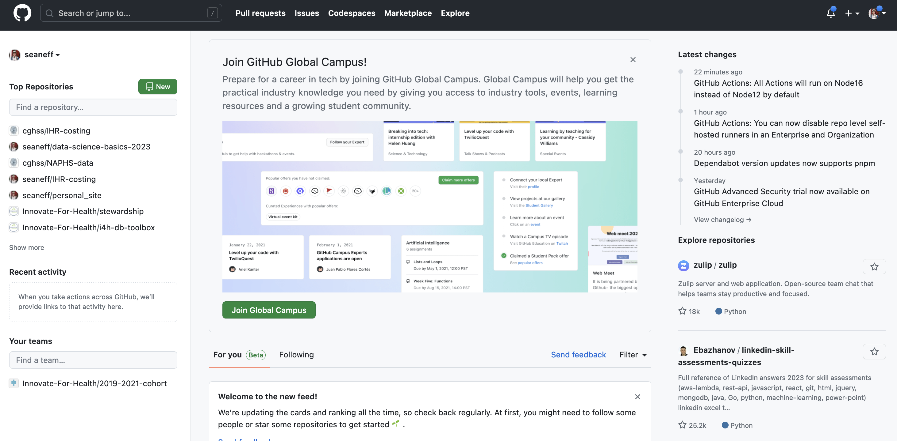
Reproducible results
Code versioning in github

Slide 67
Your turn!
Create a github account at https://github.com/
We’ll work with this some more tomorrow.

Slide 68
Data, questions, and exploratory analysis

Slide 69
What are your goals?
Who is your audience?

Slide 70
Start with a question
Good analysis requires that we first understand what we’re trying to learn or accomplish, and who our final audience is
Research question
Company/organizational goal
Communication objective
Based on this, everything else starts to fall into place. We can identify the best available data, figure out the “right” methods to analyze or visualize them, and then communicate those results to the appropriate audience

Slide 71
Data analysis as a multi-part process
Understand the questions and goals
Identify the data available (and the gaps)
Analyze and visualize the data to answer our questions

Slide 72
Our current dataset: let’s chat
Understand the questions and goals
Identify the data available (and the gaps)
Analyze and visualize the data to answer our questions
countries dataset in our R environment
Notes:
bit.ly/3qs51XU

Slide 73
Your turn
What other questions could we answer with this dataset?
What additional data could we add (or use instead) to help us ask new questions? → focusing on UN SDG data
https://unstats.un.org/sdgs/indicators/indicators-list/

Slide 74
You tell me
As we saw, it can take a bit of time to get a nice clean dataset for plotting, and significantly reformatting data is beyond the scope of our four day workshop
BUT this is something I can help with! Let me know if you’d like to work with any additional SDG data tomorrow and I can help by pulling the data before tomorrow’s class
https://unstats.un.org/sdgs/indicators/indicators-list/

Slide 75
Thank you!
See you tomorrow.
Please come with a fully charged laptop.
Lecture and course material adapted from Intro to R materials created by Alex Douglas, available online here, with corresponding free online textbook.

Slide 76
Appendix:
Creating a new github account

Slide 77

Create a github account

Slide 78
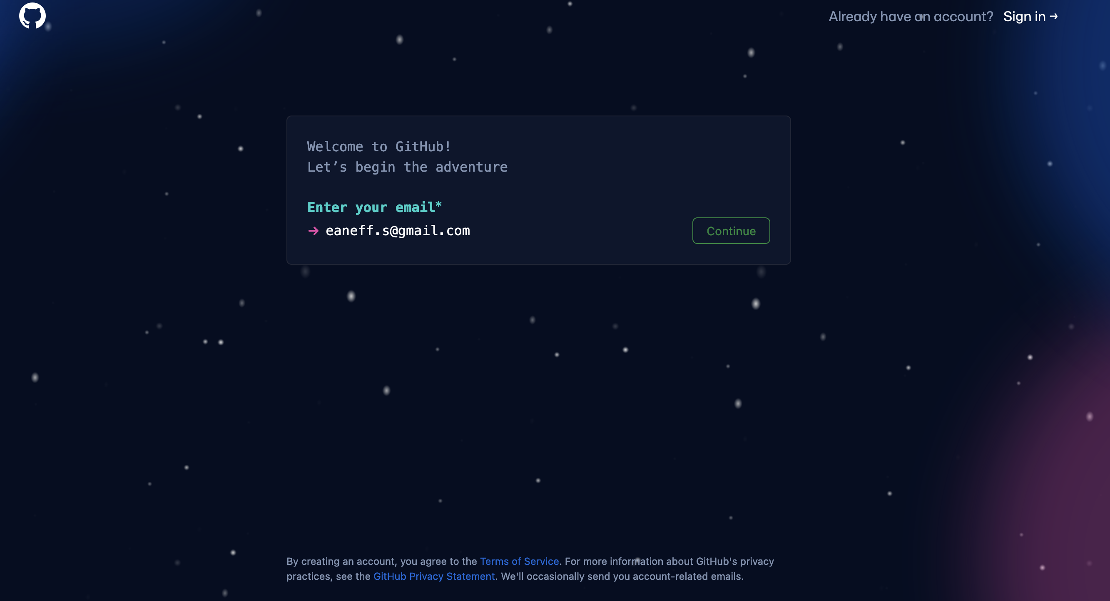
Create a github account

Slide 79
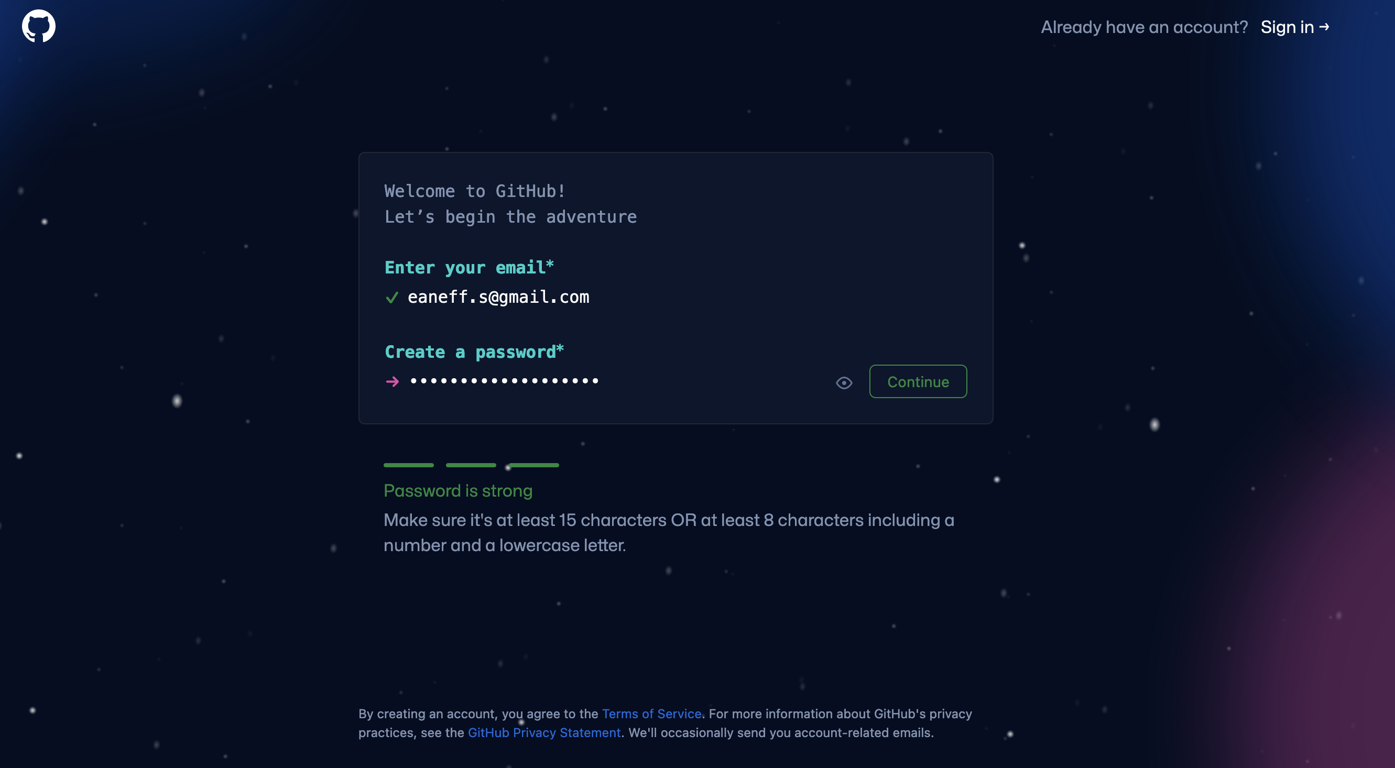
Create a github account

Slide 80
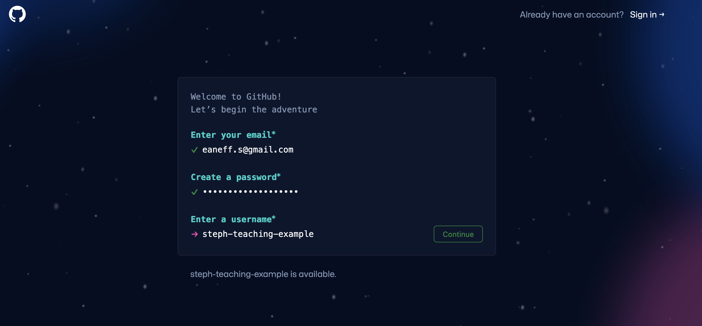
Create a github account

Slide 81
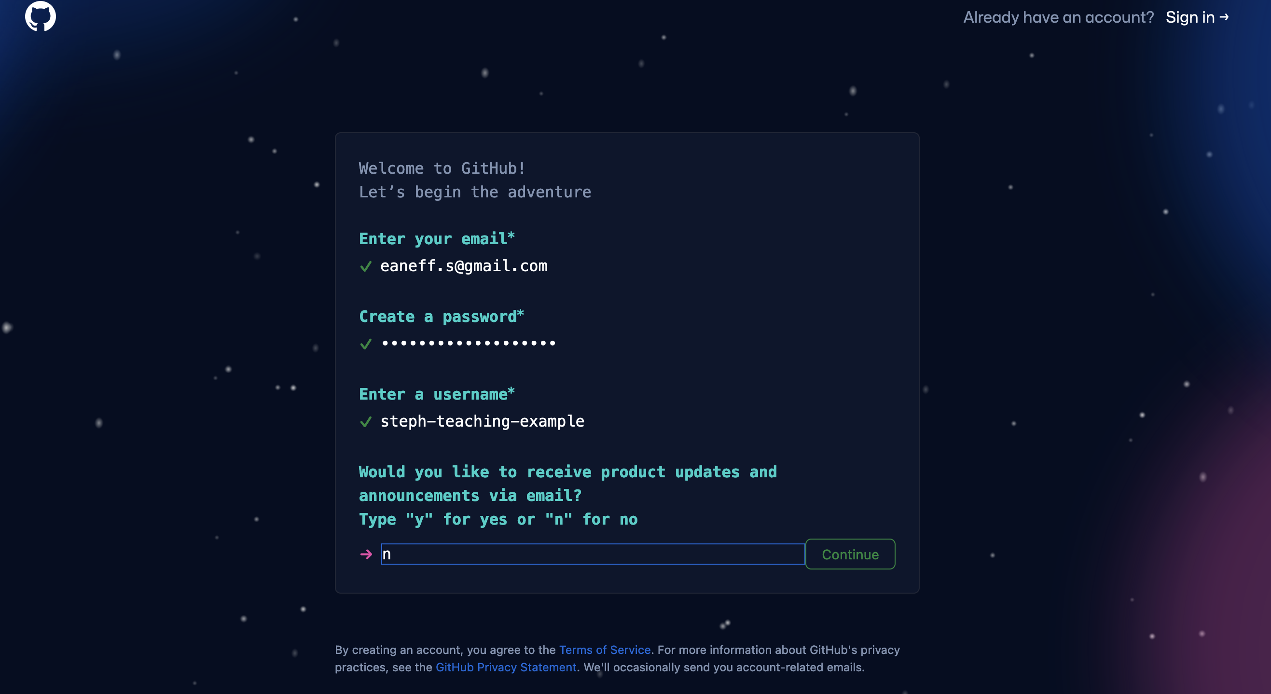
Create a github account

Slide 82
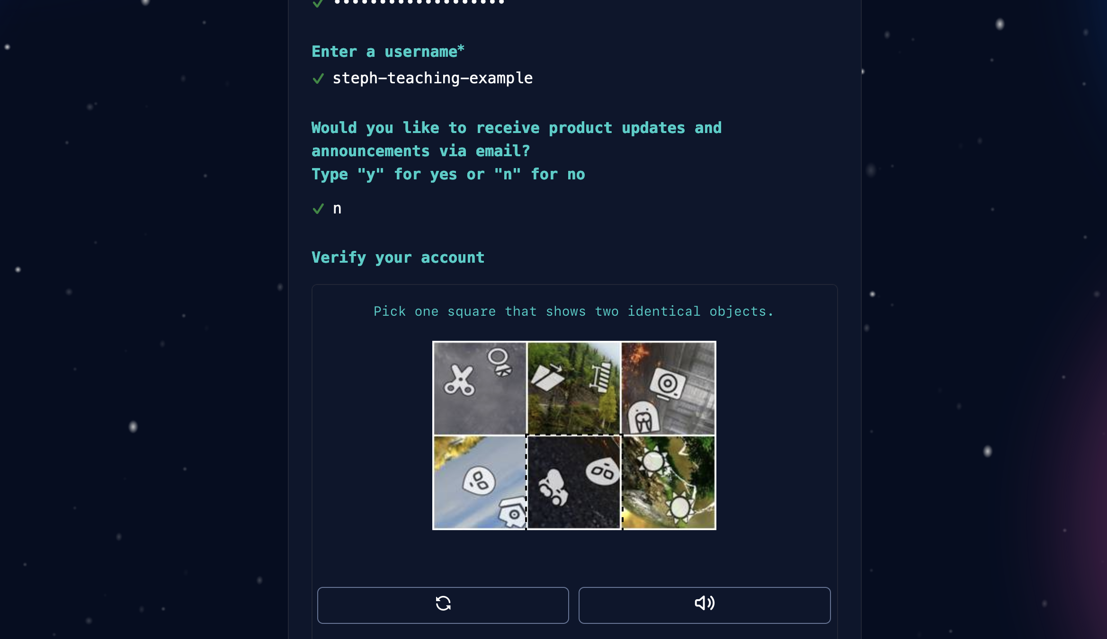
Create a github account

Slide 83
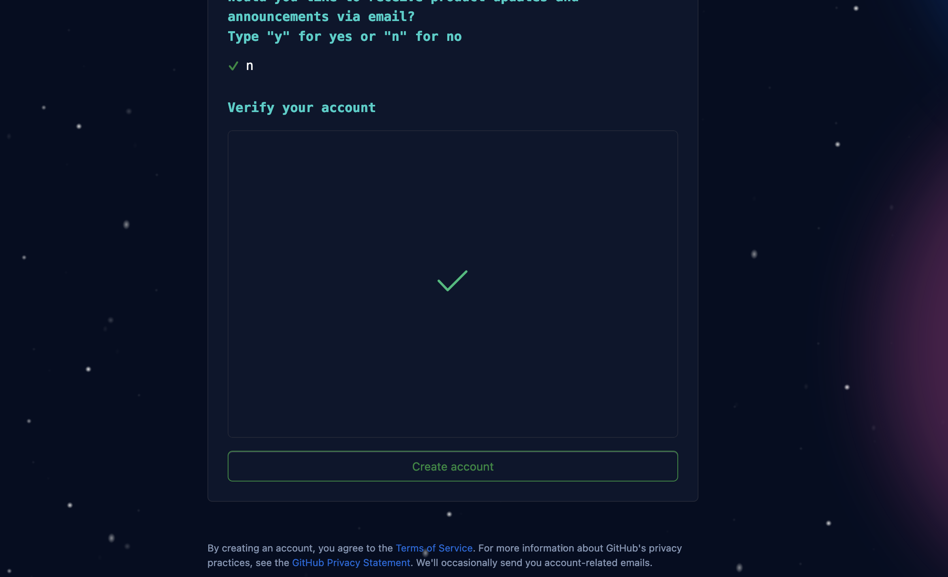
Create a github account

Slide 84
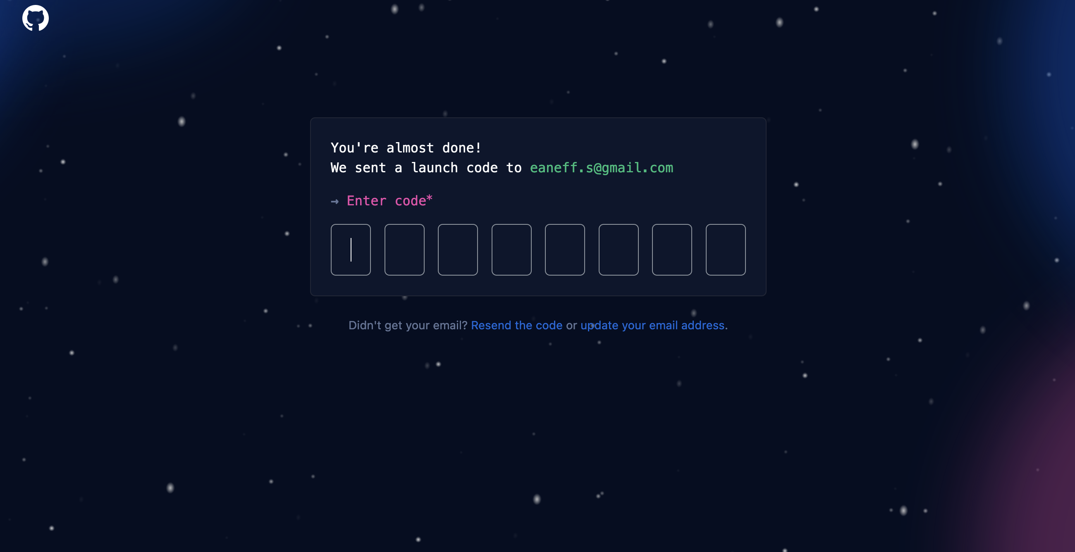
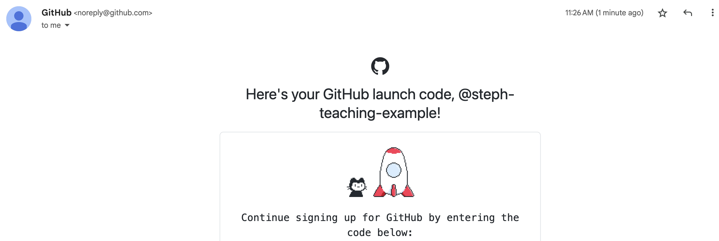
Create a github account

